Slide 1
FPGA MINI PROJECT
TOKEN-BASED QUEUE
MANAGEMENT SYSTEM
An FPGA-based digital token generation
and service-counter controller
Verilog HDL | Xilinx Vivado | ZedBoard
Presented by:
Vishruthaa V J (312324106189)
Yaazhini R (312324106190)
Sanyo S B (312324106149)
Rupika Sri S (312324106138)
Swetha S (312324106175)
DIGITAL QUEUE
CONTROL

Slide 2
Introduction & Problem Statement
Why a digital token queue is useful
WHAT IS A TOKEN-BASED QUEUE?
THE PROBLEM
A digital system that assigns sequential token numbers and helps a service operator call customers in order.
Manual queue management can create confusion, crowding and difficulty maintaining the correct service order.
REAL-WORLD APPLICATIONS
HOSPITALS
BANKS
PUBLIC OFFICES
Patient token calling
Customer service counters
Help desks and citizen services

Slide 3
Project Objectives & Key Features
A compact FPGA controller for token generation and service order
MAIN OBJECTIVE
Generate tokens, call the next waiting customer and display queue status using the ZedBoard's onboard LEDs.
01 TOKEN GENERATION
02 NEXT CUSTOMER
Press BTNU to generate the next sequential token. The token count is limited to 15.
Press BTNR to advance the serving number only when a customer is waiting.
03 RESET
04 LED DISPLAY
BTNC clears both token registers.
Eight LEDs show generated and serving values.

Slide 4
Hardware & Software Requirements
Tools used to implement the FPGA mini project
HARDWARE – ZEDBOARD
SOFTWARE – XILINX VIVADO
• Zynq-7000 development board
• Onboard 100 MHz clock
• BTNC – Reset
• BTNU – Generate token
• BTNR – Call next customer
• LD0–LD7 – Token display
• Create an RTL project
• Write Verilog HDL source
• Add XDC pin constraints
• Run synthesis and implementation
• Generate the bitstream
• Program FPGA using Hardware Manager
No external keypad, LCD, sensors or additional modules are required for the basic demonstration.

Slide 5
System Architecture & Working Principle
From push-button input to LED output
PUSH BUTTONS
CONTROL LOGIC
TOKEN REGISTERS
LED OUTPUTS
BTNU / BTNR / BTNC
Edge detection
and conditions
Last token
Serving token
Generated and
serving values
STEP-BY-STEP OPERATION
1. RESET
2. GENERATE
3. CALL NEXT
4. DISPLAY
Both registers become 0.
BTNU increases last_token.
BTNR advances serving_token.
LEDs show both values.

Slide 6
Verilog HDL Implementation
Important registers, conditions and sequential logic
TOKEN REGISTERS
BUTTON EDGE DETECTION
last_token stores the newest generated token.
serving_token stores the current service position.
btnU_prev and btnR_prev detect a new sampled press so a held button does not repeatedly increment.
TOKEN GENERATION
SERVING CONDITION
if (last_token < 4'd15)
last_token <= last_token + 1'b1;
if (serving_token < last_token)
serving_token <= serving_token + 1'b1;
OUTPUT MAPPING
led[7:4] = last_token | led[3:0] = serving_token

Slide 7
SYSTEM BLOCK DIAGRAM
Token-based queue management using Verilog HDL on the ZedBoard FPGA
PUSH-BUTTON
INPUTS
BTNU – Generate
BTNR – Next customer
BTNC – Reset
INPUT CONTROL
LOGIC
Clock sampling
Edge detection
Button conditions
TOKEN
REGISTERS
last_token
serving_token
4-bit values
QUEUE STATUS
LOGIC
Check waiting tokens
Prevent invalid advance
Update service position
LED
OUTPUTS
LD7–LD4: Last token
LD3–LD0: Serving token
8-bit display
100 MHz CLOCK
Provides synchronous timing
RESET CONTROL
BTNC clears both token registers
TOKEN LIMIT
Generation stops at token 15
All blocks are editable. Arrows indicate the functional flow from button input to LED status display.

Slide 8
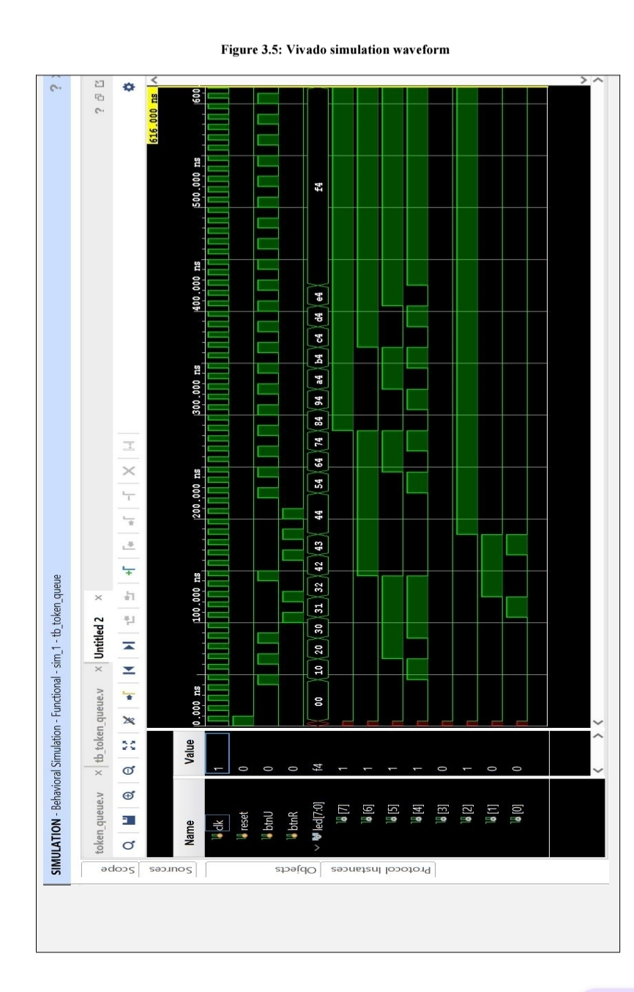
SIMULATION OUTPUT
Vivado behavioral simulation waveform for the token-based queue management system
Figure: Vivado simulation waveform showing token and LED signal activity.

Slide 9
Testing, Results & Limitations
Expected behavior during the hardware demonstration
Operation | Last token | Serving token | Waiting
Initial state | 0 | 0 | 0
Generate 3 tokens | 3 | 0 | 3
Press NEXT | 3 | 1 | 2
Press NEXT again | 3 | 2 | 1
Generate one more | 4 | 2 | 2
Complete service | 4 | 4 | 0
LED INTERPRETATION
LD7–LD4: Last token
LD3–LD0: Serving token
Example: 0101 0011 = 5 and 3
CURRENT LIMITATIONS
• Token range: 0–15
• Binary LED display
• Button bounce may cause extra counts
• One service counter

Slide 10
Future Enhancements & Conclusion
Possible improvements and project outcome
FUTURE ENHANCEMENTS
CONCLUSION
• Add clock-based button debouncing
• Add queue-full and queue-empty indicators
• Use a seven-segment display
• Extend token width for larger queues
• Support multiple service counters
The project demonstrates how a practical service-queue process can be implemented using digital logic and FPGA technology. Verilog HDL and the ZedBoard generate sequential tokens, call waiting customers in order and display queue status through onboard LEDs.
THANK YOU!
Questions & Discussion

